Slide 1

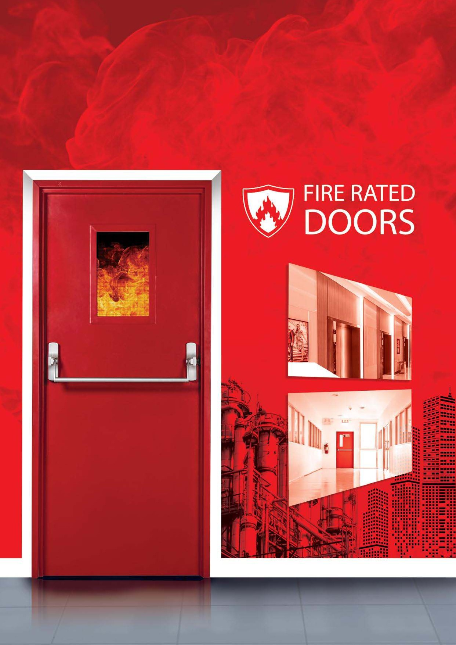




KROSS INNOVATIONS

Slide 2





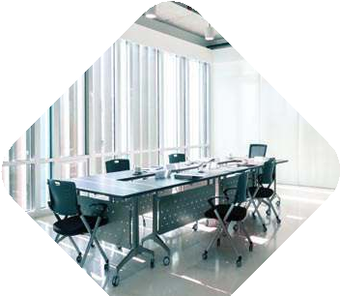


UNIQUE SOLUTIONS FOR WIDE RANGE OF APPLICATIONS
KROSS INNOVATIONS
INDUSTRIAL
COMMERCIAL
MEDICAL
EDUCATION
HOSPITALITY
CORPORATE
RELIGIOUS
GOVERNMENT

Slide 3

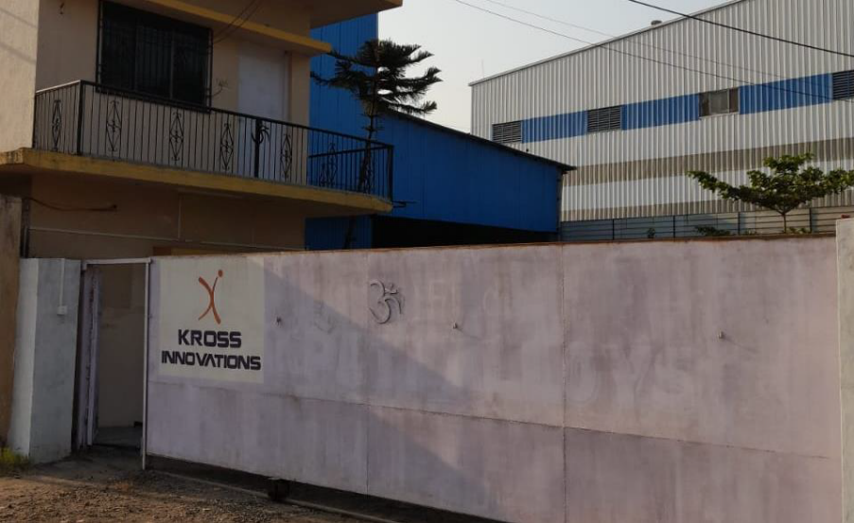
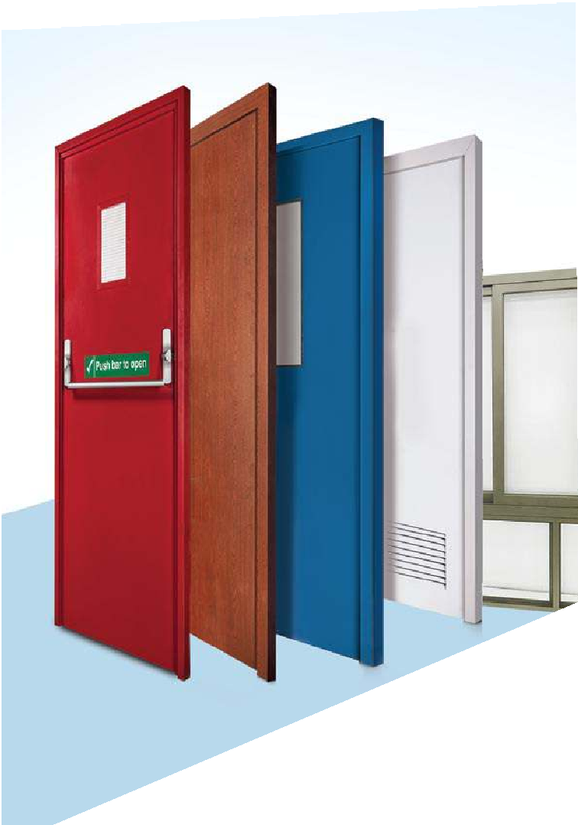
KROSS INNOVATIONS
K r o s I n n o v a t I o n s was established in India in 2011. We have all required necessary certifications as per industry norms. Our Fire rated Doors have 2 Hrs Fire Rating as per BS 476, Part 20. Doors are tested at one of most reputed research and testing Laboratory, CBBRI, Roorkee.
KROSS INNOVATIONS
Kross Innovations are offering innovative solutions at affordable prices now has a new chapter with the introduction, Our doors are manufactured from state of the art technology to ensure supreme resistance to fire. Factory-Engineered to perfection, every product is uniform in quality and finish.

Slide 4
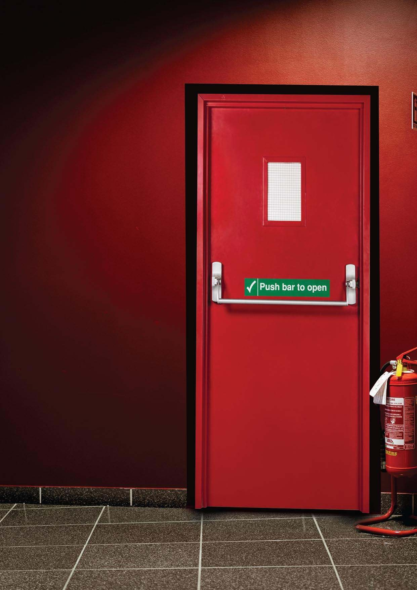

KROSS INNOVATIONS
Passive Fire Protection in
Your Building and Its Importance
Buildings need to be designed to offer an acceptable level of fire safety and minimize the risk and damage of fire. The primary objective of fire protection components is protect the life and property within your building. Most people are familiar with the basics of fire suppression sprinklers, fire extinguishers, etc., which are part of Active Fire protection components.
But the passive fire protection that actually contains a fire at its point of origin or prevents the spread of fire, can be invisible and nearly forgotten - until the day you come to truly appreciate and depend
on it. Passive fire protection is not only a necessary safety precaution but is also
required by law, as it is designed to provide an effective system built into the structure of a building which restricts the growth and spread of fire.
Fire doors remain one of the important passive fire protection components of your building. They serve four main purposes:
Suppress the spread of fire
Reduce smoke hazards by containing smoke
Provide ready egress from fire
Serve as regular doors with access control as an option

Slide 5



















CHECKLIST FOR
FIRE DOORS
KROSS INNOVATIONS
Ensure Fire rated Door closer
Highly recommended
to be purchased along
with the shutter to ensure the frame is of same standard as the door
Ensure Door locks and handles are Fire rated as per the norms
Intumescent strip and the smoke seal resist the passage of smoke and fire
9
Ensure Hinges are fire rating tested along with the door set
Ensure Vision Panel is Fire rated

Slide 6

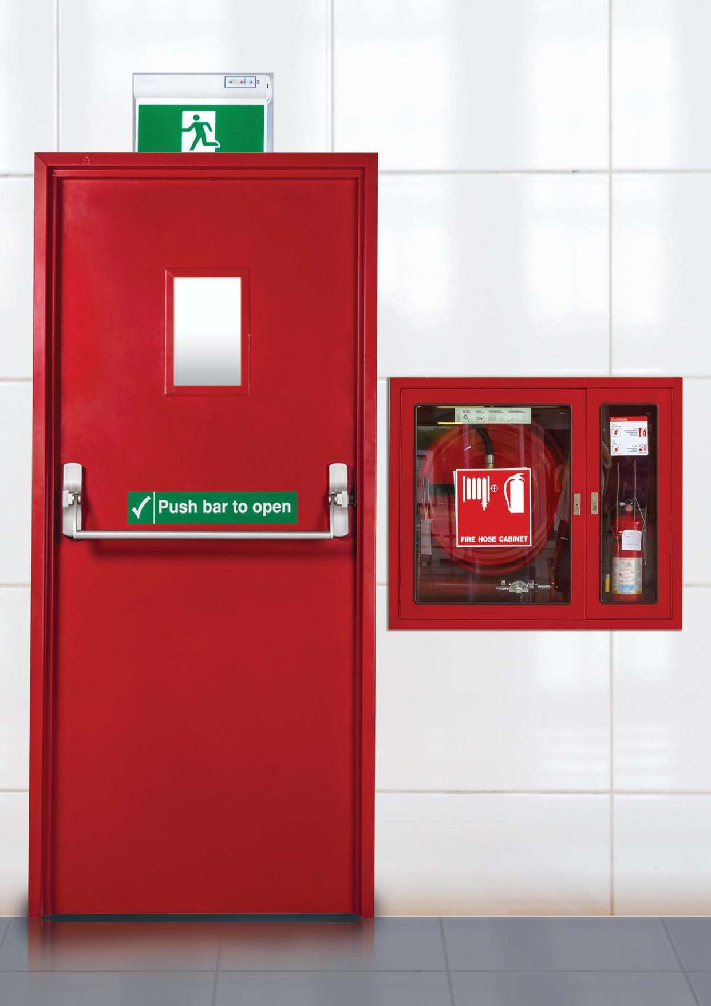
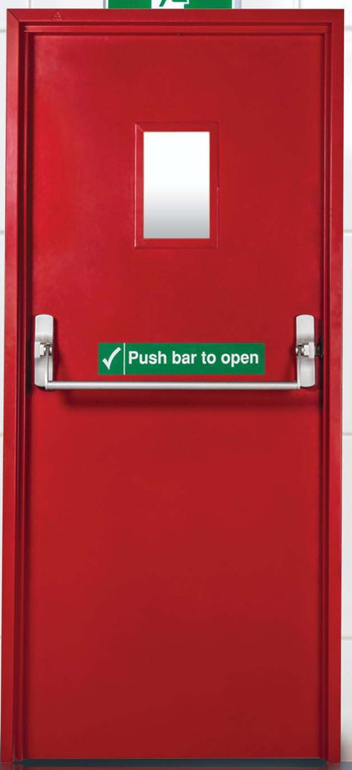
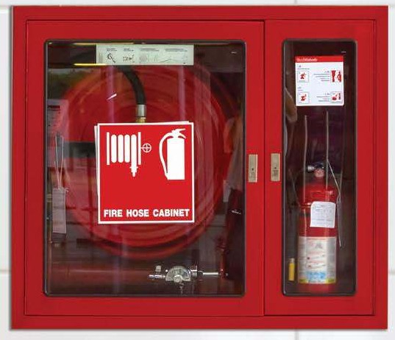
FIRE DOORS
KROSS INNOVATIONS
These doors can be used in high-rise building, metro railways station, telecom centres, power plants, cellular network stations, garment processing units, shopping malls, industrial plants, multiplexes, hotels, auditoriums, software parks, restaurants
etc. These doors and frames are designed to perform in the most demanding environment.

Slide 7
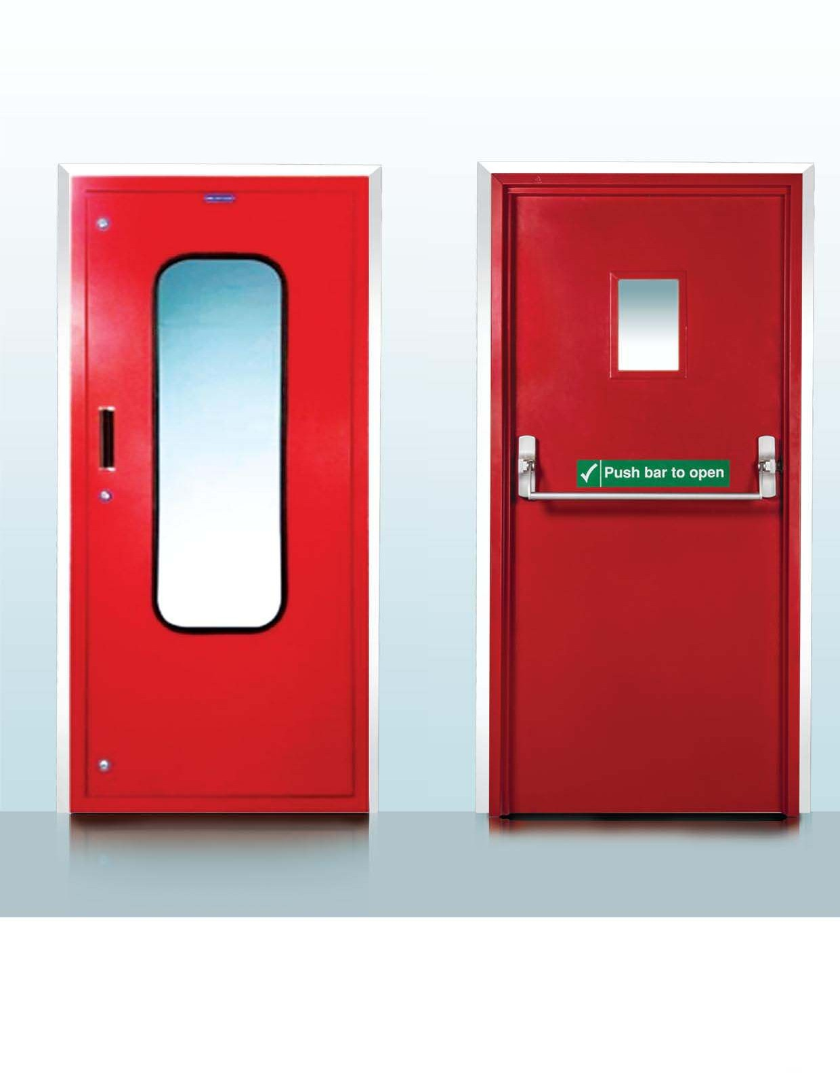
KROSS INNOVATIONS
SHAFT/DUCT ACCESS
DOORS
FIRE RATED
DOORS

Slide 8
KROSS INNOVATIONS
FEATURES OF FIRE DOORS:
Honeycomb/Rockwool/Mineral wool core in-fill for structurally flat surface
Available in galvanised or stainless steel
Shutter thickness of 43 mm
Fire rating of 120 minutes for stability and integrity (IS/ BS)
UL labelled doors for 90 minutes
No welding joints and sharp edges, interlocking at the stiles
Factory prepped to receive all Mortise hardware specified
High aesthetics and robust structure
Fully flush constructions
Easy flush constructions
Easy to install on a flush wall opening and dry wall partitions
Can be supplied in a wide range of colours/Wood Finishes
Single Leaf Fire rated Door with Panic Bar
Double Leaf Fire rated Door with Panic Bar & ‘D’ Handle
OPTIONAL FEATURES:
Insulated doors with 120 minutes rating
Wood grain can be provided as an optional finish
Double doors and doors with vision lite are available
Doors are tested at CRBI (Central Building Research Institute)
WARRANTY
All products carry minimum ONE YEAR warranty

Slide 9




TECHNICAL SPECIFICATIONS
KROSS INNOVATIONS
ITEM
TYPES OF DOORS
Fire Rated Doors (2 Hours)
Constructed from 1.2mm thick Skin pass Galvanized Iron sheet or from 0.8mm (22 SWG) thick Skin pass Galvanized Iron Sheet
Door Leaves
Thickness
43mm
In-Fill
Rockwool/Mineral Wool/ Honeycomb Kraft Paper
Constructed from 1.6mm thick Skin pass galvanized Iron sheet or from 1.2 mm thick Skin pass Galvanized Iron sheet formed to single or double rebate profile of size
Door Frames
Profile Dimension
0.135m X 0.055m (+/-0.03m)
Bending Radius
0.0014m
Vision Glass
Material
5mm thick clear/wired glass Circular or Rectangular
Rectangular Dimension
0.2m X 0.3m
Coating
The door frames and door shutter are primed with Zinc-Phosphate Stoving Primer and finished with Polyurethane Aliphatic grade of epoxy paint as required
Powder Coating Material
Powder Coating Thickness
Epoxy Polyester / Pure Polyester / Polyurethane
60-65 Microns (Dry film Thickness)
Accessories
Material - Stainless Steel Ball Bearing Butt Hinges, Dimensions - 0.102m X 0.076m, Thickness - 3mm
Hinges
Mortise Sash Lock with Lever Handles, Mortise Dead Bolt, Mortise Latch, Panic Devices etc. can be provided as required
Lock
Flush Bolts
(Double Doors)
Concealed extended lever action flush bolts provided on the top of the door to the leading stile edges
Doors are made suitable to receive a large variety of door closers
Door Closers

Slide 10
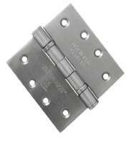
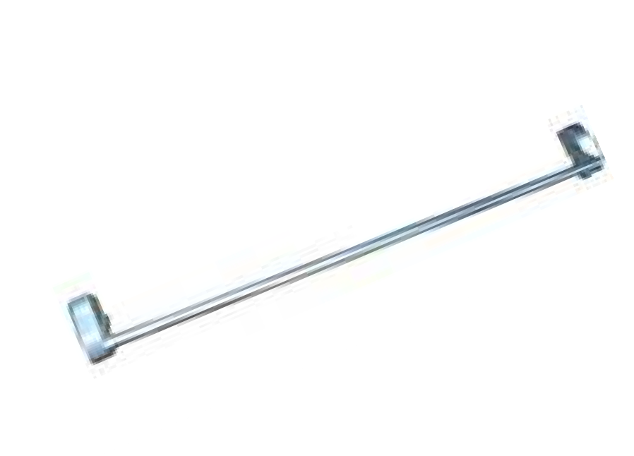

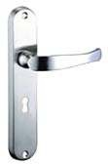
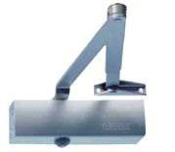

KROSS INNOVATIONS
Best-In-Class Hardware to provide a long and damage-free life.
Hinges
Make-Geze/Hettich/Dorma/
Kich
Panic Bar
Make-Geze/Hettich/Dorma
D-Handle
Make-Geze/Hettich/Dorma/
Kich
Main Door Lock
Make-Geze/Hettich/Dorset/
Kich
Door Closer
Make-Dorset/Geze/Hettich/
Dorma/Assa Abloy/Kich
Mortise Dead Lock
Make-Geze/Hettich/Dorma/
Kich

Slide 11
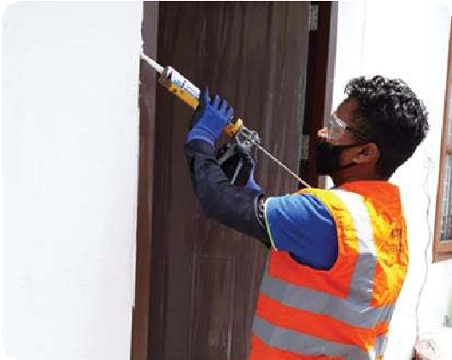
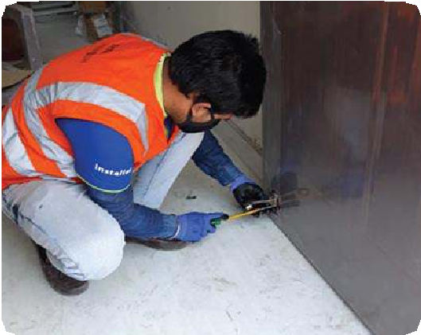
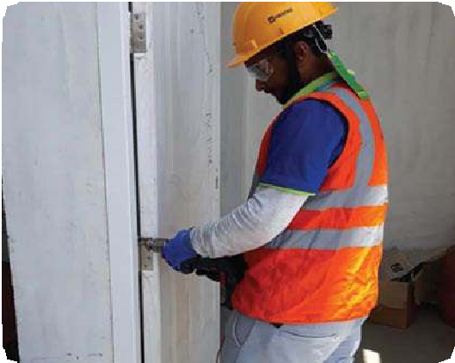



INSTALLATION TEAMS
KROSS INNOVATIONS
EXPERIENCED CARPENTERS
EXPERIENCED DOOR SHUTTER AND FRAME INSTALLERS
EXPERIENCED IRON FRAME INSTALLERS
Trained and Experienced Installers
Installed with modern tools and techniques
Certified installers

Slide 12
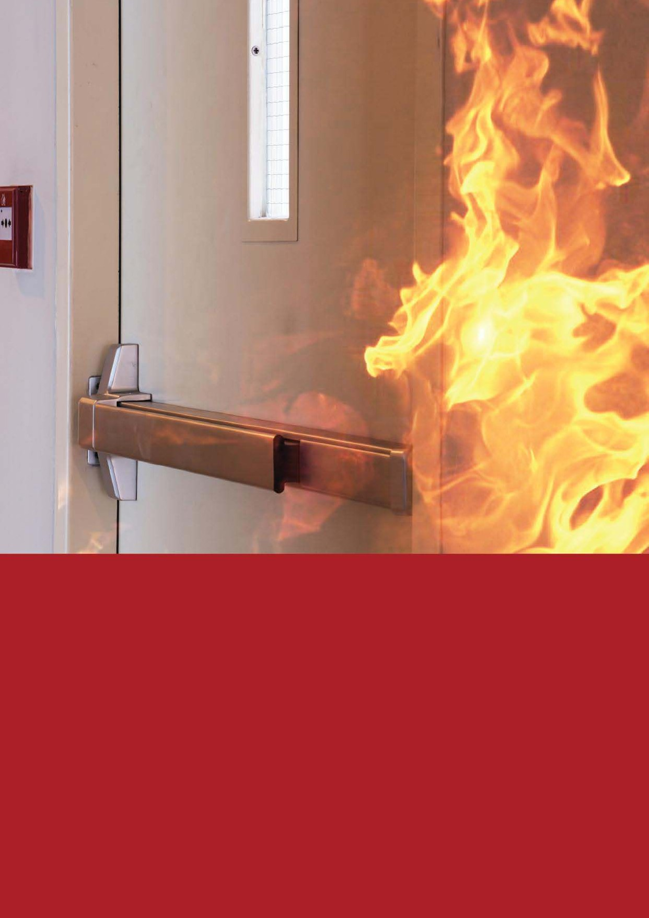
FAQs
ON FIRE DOORS
KROSS INNOVATIONS

Slide 13
What is infill of shutter in case of fire rated doors?
Both Rockwool and Honeycomb can be provided.
What kind of fire seal we put in our doors?
We use Lorient, Pemko, NGP, Dorma Fire Seal.
What is a stiffener and what is use of same?
Stiffeners are made of steel and used inside the door for the hardware functioning
What is a trim and where is it used?
Trim is a handle/lock used with panic bar
Does panic bar installation involves extra cost?
Yes
Till what temperature our fire resistant doors are tested?
850 degree
How is a shaft door different from a fire rated door?
Shaft doors are used for entry to the restricted places like electrical ducts, fire ducts etc. typically smaller than normal door. It can be fire rated as well as non fire rated
What is single panel shaft door, how is it different from double panel?
Only one steel sheet is used in single panel shaft door
What is maximum height and width possible for single leaf FRD?
Height – 2.5 m width – 1.2m
These are general size requirement, if the sizes are bigger we suggest double leaf doors
Are all FRD double rebate, why?
Yes because with double rebate, higher stability can be achieved.
What are criteria for which we have been given fire rating on our doors for 2 hours ?
As per CBRI Testing
Can we give fire rating of 1 hour / 2 hours on insulation?
We can provide upto 2 hours insulation
How much fire rating a rockwool of honeycomb provides on installation?
2 hours as per the CBRI testing condition
Is fire rating possible with vision glass on 0.8*1.2 configuration as well?
Yes, as we provide Fire rated Vision glass
Can we provided fire or commercial doors with access control mechanism?
Yes, we can provide access control mechanism
What are various types of fire rated glass available?
We provide Schott Pyran fire rated glass
Silicon gel that we use is fire rated?
Yes, Silicon Sealant is fire rated
How does in-fill affect fire rating?
Rockwool can withhold fire for more time than Honeycomb. More efficient in blocking the transfer of heat
What are various certifications that we have for fire rating?
CBRI
What is active door and what is inactive door?
The leaf which is fixed by flush bolt is called inactive door and the other one is called active door, which is operated
How many number of hinges are put in a FRD and is it related to height?
Depending on the height 3 to 4 hinges may be used
How much warranty do we provide on FRD?
1 year
KROSS INNOVATIONS

Slide 14


Mumbai Office:
2nd Floor, Office No. 215, New India Industrial Estate, Off Mahakali Caves Road, Andheri East, Mumbai 400093
Factory :
Plot #17-20, Survey No.328/1/1/2, Daman Ganga Industrial Estate, Masat, Silvassa, DNH - 396230
Contact us –
Anand Chandnani | andand@krossinnovations.com | +91 77368 07375
Sandeep Maheshwari | sandeep@krossinnovations.com | +91 99303 40743
20

